Slide 1
CLIMATE CHANGE
Geon Kim, Elia Morhej and Brandon Nguyen

Slide 2
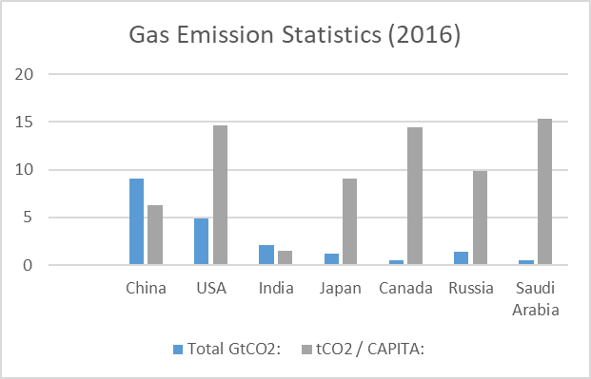
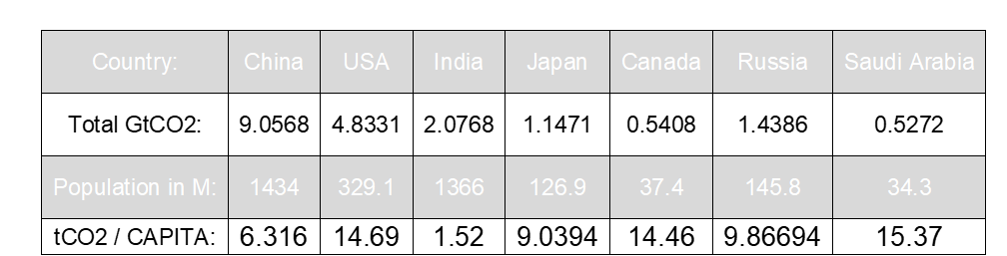
First table and chart

Slide 3
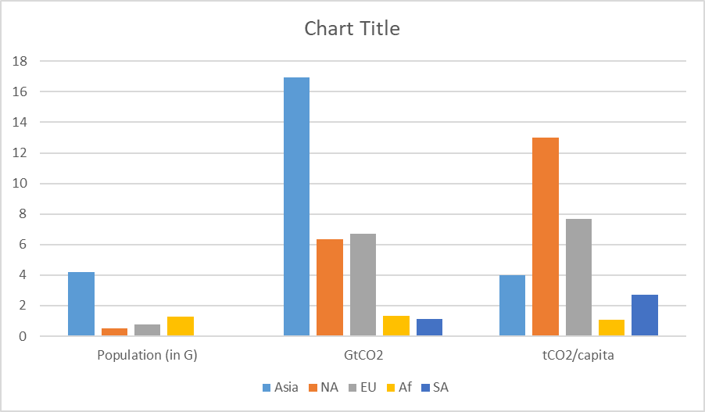
Second table and chart

Slide 4
ETHICS
Question: Has reducing gas emissions become a worldwide responsibility for everyone despite it not affecting everyone equally?
Stakeholders: People indirectly affected (IDR), People directly affected (DR), Government, Companies
IDR: Effort and time to adapt to a new lifestyle (loss)
Government: Reduced funding for other sectors (loss) / Gains more taxes (gain)
DR: Mental and physical health (loss) / Get more support/help from organizations (gain)
Duties
IDR: a moral duty to help those in need
Government: research to facilitate being ecological for the people
Companies: use more renewable energy options for their industrial needs
Consequentialism: the world will overall be a better place for absolutely everyone if everyone truly sees taking care of the environment as a responsibility.
Deontology: you have a duty as a citizen of the Earth to take care of the environment for your sake and for others.

Slide 5
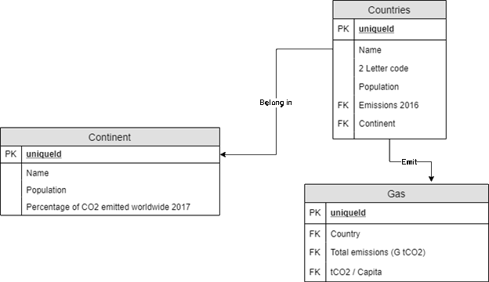
ER Diagram

